Slide 1

ENTERPRISE IRELAND
@ Who to Talk to 2014 Tipperary.
Catherine Hogan LIT Tipperary Thurles 2014

Slide 2

Our Mission
We help innovative
Irish companies become
leading global players
in markets worldwide

Slide 3

Our Clients
Entrepreneurs and Early Stage
High Potential Start Up Companies with the potential to employ > 10
Manufacturing and Internationally Traded Service companies
employing > 10
Export Oriented

Slide 4
Our Focus
Existing Clients
New Clients
The Enterprise Eco-System

Slide 5


Developing the Enterprise
Eco-System
We create opportunities
Connecting innovative Irish
companies to global customers
Investing €87 million in science
and technology infrastructure and research
Introducing investors to
expanding companies
Market for Risk Money
Innovation Infrastructure
Enterprise Space
Networks
Awards, Events, Initiatives
New Exporters
Support for Local Enterprise Offices
& Údarás na Gaeltachta

Slide 6

Client Services
Customised to Needs
Across all aspects of the business
Strategy
Leadership & Management Development
Finance
R & D
Operations
Sales & Marketing
Financial & Non Financial
Advice, Information & Contacts

Slide 7
Irish exports at all time high: upward trajectory continues

Slide 8










Who bought Irish in 2013?
+14%
+3%
+9%
+4%
+7%
+19%
+9%

Slide 9
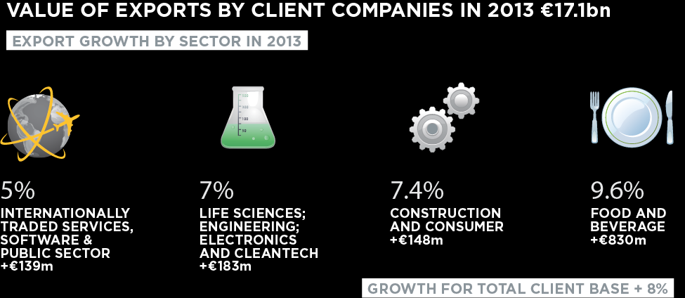
Where was the growth?
....Across All Major Sectors

Slide 10
Supporting the Development of
High Potential Start Up (HPSU) Companies
The company must be :
Recently established – Less than 5 years old
Innovative (operating in a growth sector).
Capable of generating at least :
  10 full time jobs (in Ireland) – in 3-4 years
  Annual revenues of €1m – in 3-4 years
International sales focus
Headquartered & controlled in Ireland
Also Strong Management Team

Slide 11
Pre Start-Up Supports
Pre Start-up Advisor
Initial Screening Service
Outline business proposition
One-to-one consultation
Notes:
11
Discuss your idea , establish if your business is eligible & provide info on supports that may be available and get advice on moving forward
2/3 page summary giving the background, experience of main promoter, overview of business proposition, target market & validation to-date, funding requirements & next steps
Informal meeting arranged to discuss business proposition in more detail, not an investor pitch & no decision from this meeting. Allows you to discuss the origins of business idea, your plans for the business & your development needs
If proposal appears eligible but is at early stage & lacking information, advisor will advise on further develop proposition – Start-Up Development Programme

Slide 12
Start-Up Development Programme
Enterprise Start One
Enterprise Start Two
One-to-One Mentor
New Frontiers Programme
Notes:
These programmes help address some of issues - Value proposition is not clearly defined. Technically brilliant product but does it deliver VALUE to the customer?
Inability to identify and qualify the customer.
“Our product has no competitors” !
Unbelievable numbers (revenue projections and costs).
Unrealistic expectations on raising cash (time needed and valuations). It will take 3-6 months. Plan conservatively

Slide 13

Money
Access to Money
Space
Innovation Vouchers
Feasibility Grant
New Frontiers Stipend
Competitive Feasibility Fund
Competitive Start Fund
€10m Int. Start Fund
Innovation Partnership
HPSU Funding
Business Angel Partnership
Business Angel Network
Seed Capital Funds
Venture Capital Funds
Horizon 2020
Introduction to Investors +
Incubators x 15 IOTs
Incubators at Universities
4 x Bio Incubators
110+ Community Enterprise
Centres
Advice & Intelligence
Mentors
Mentor Panels
Market Research Centre
Independent Business Advice
Sector,Tech & Market Advice
Support & Introductions
EI Network
10 Regional Offices in Ireland
30 Overseas Offices
+ 1st Reference Customers
International Start Up
Ambassadors
SUPPORTS
FOR
START-UPS
Awards
Development Programmes
Student Entrepreneur Awards
Clinical Innovation Award
+ Partner in range of other
Start Up Awards
Enterprise Start
New Frontiers – 3 Phases
Food Works Ireland
Sprint Programme
Access Silicon Valley
BioInnovate/NUIG
HPSU Scaling /Cambridge
Going for Growth/Female
Other Supports
IOT Managers
IOT Managers Network
New Frontiers Mgr Network
CEC Managers
CEC Managers Network
HPSU Showcase
LEO Eval & App.Committees
Developing Ideas –3rd Level
Access to Ideas
Commercialisation Fund
Business Partners Programme
Technology Transfer Offices
Research Centres-Funding
Enterprise Europe Network
Knowledge Transfer Ireland
Big Ideas Showcase

Slide 14
Enterprise Ireland Contact
Catherine Hogan
Senior Regional Development Executive
Micro Enterprise & Small Business
Westpark
Shannon
Co. Clare.
Tel 061 777009
Mobile 086 2591587
eMail catherine.hogan@enterprise-ireland.com
www.enterprise-ireland.com

